Slide 1

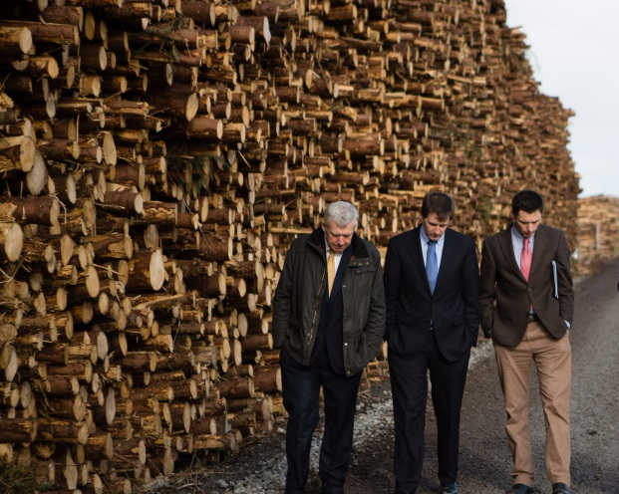
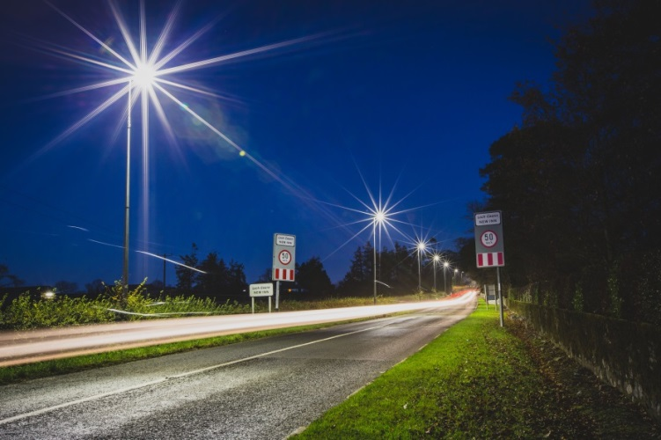
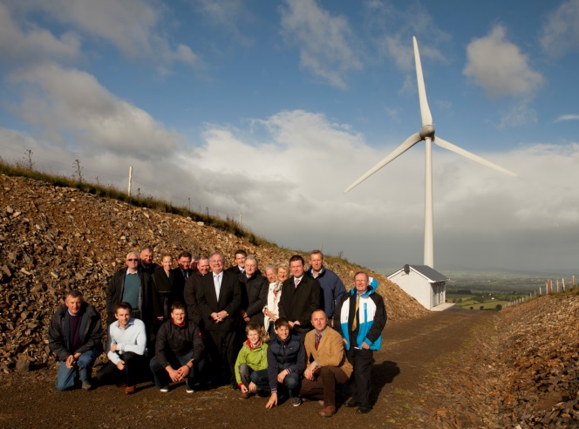
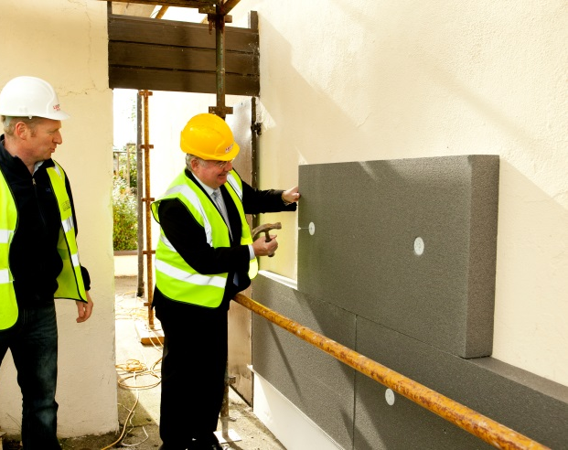
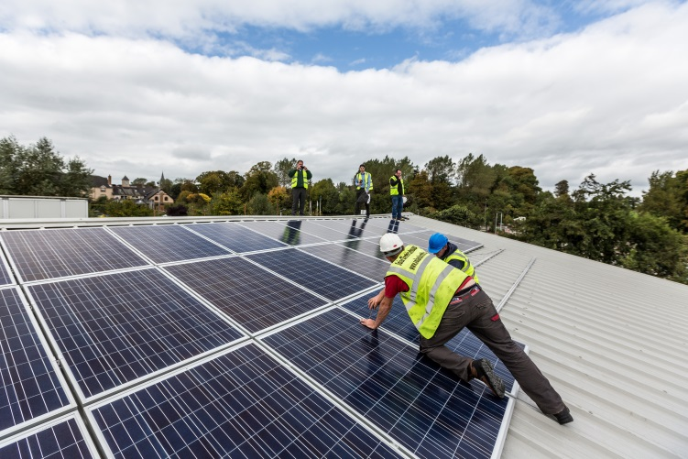
Energy Opportunities
For SMEs
Paul Kenny, B.E. C. Eng.
Chief Executive
Tipperary Energy Agency

Slide 2









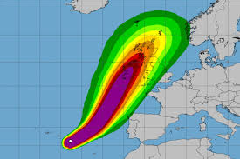
Climate Change Reality
“The latest science makes it clear that the world needs to reach zero carbon emissions globally by 2050 to maximise chances of staying below 2 degrees and to make 1.5 degrees feasible,”… Mary Robinson, NUI maynooth, Summer 2015.
Paris: “long term <2.0°C” / ”or 1.5°C”*
FEB 2016 is 1.55°C-1.75°C* - Nasa
White Paper: 80%-95% CO₂ by 2050
Energy costs are a driver, but so should climate change for anyone with any moral compass.
*above pre-industrial levels
Notes:
“ I used to not talk about climate change, as people didn’t care, it undermined credibility to bring it up, but then we realised that no one was talking about it”. I thought this was a problem for my grandchildren, then I thought it will be a problem for my kids…. Now I think it will be our challenge.

Slide 3
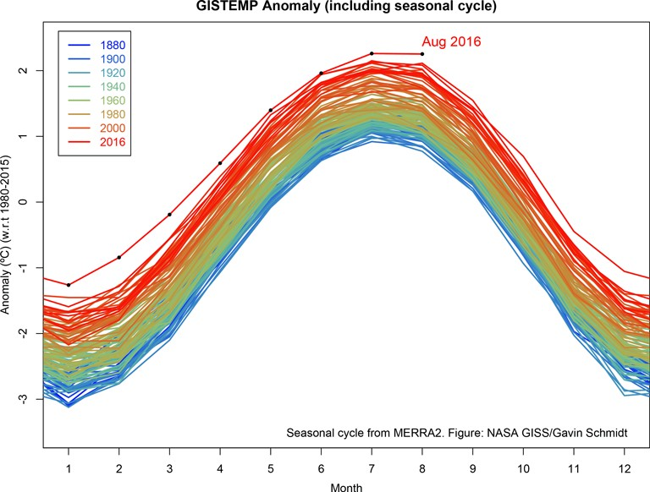

Slide 4
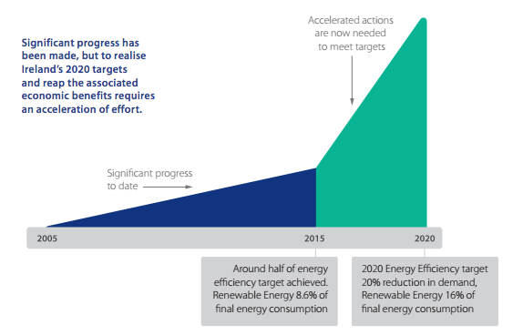
Challenge

Slide 5
Budget
Energy efficiency
Additional €24 million to expand energy efficiency programmes
€100 million spend on energy projects in 2017
€7 million was being allocated to a new renewable heat incentive scheme for 2018.

Slide 6
What is the Covenant of Mayors ?
The Covenant of Mayors is a European initiative by which towns, cities and regions voluntarily commit to reducing their CO2 emissions beyond this 20 % target.

Slide 8
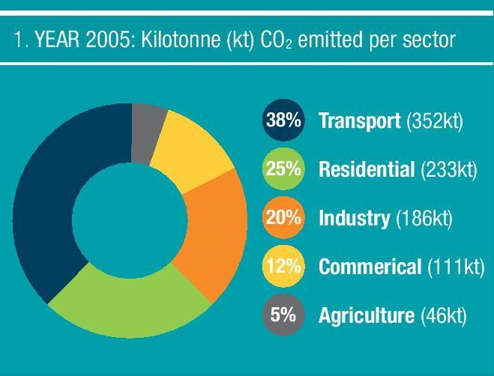
Sustainable Tipp

Slide 9

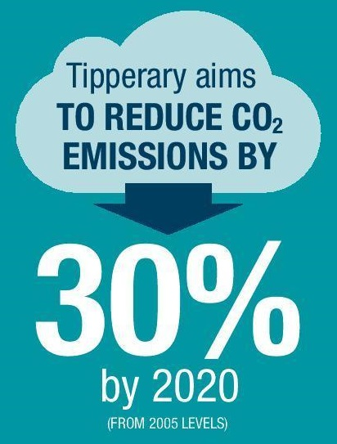

Slide 10
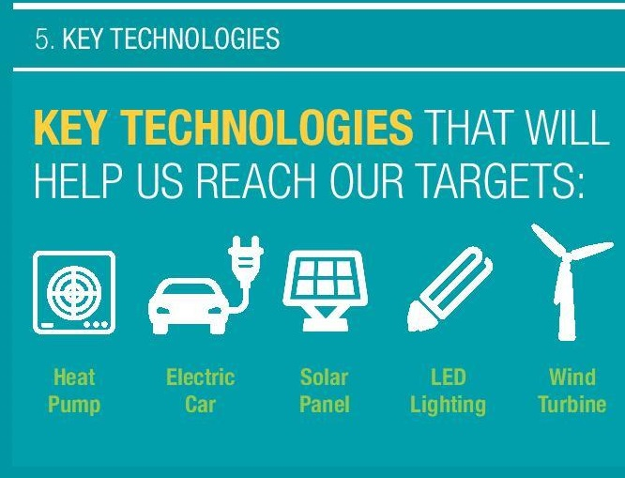

Slide 11
Energy Audit
Pre-analysis and planning
Conducting the site visit
Technical assessment
Financial analysis of opportunities
Identifying and prioritising opportunities
Reporting the results
Notes:
Main goal of most businesses (organisations):
“To reduce the input energy cost’s with as little management input as possible.”
Extra benefits:
Sustainability of business (environment / price shocks etc.)
Green image
Energy costs = Bottom line profit.
How much extra sales to make ~ 10% Energy savings

Slide 12
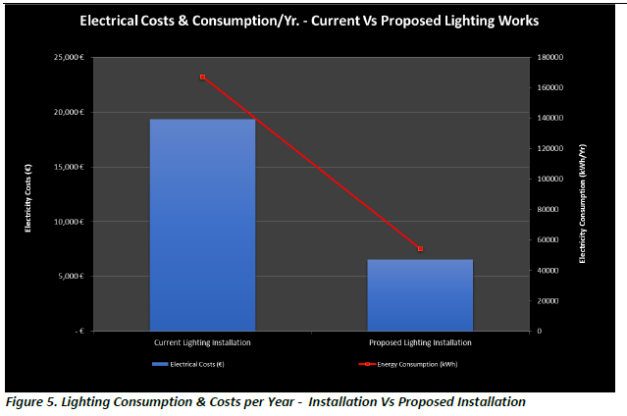
Energy Audits
Notes:
Data Analysis
Usually 20-40% of typical buildings energy use
Technology has changed significantly
Like for like replacements can be good.
Full re-design with controls saves (40-60%)

Slide 13


BEC Available Funding
30% Private Sector
50% Private Sector
Grant amount at application stage cannot be exceeded
Tipp Energy - €9M drawn down from SEAI since 2010

Slide 14
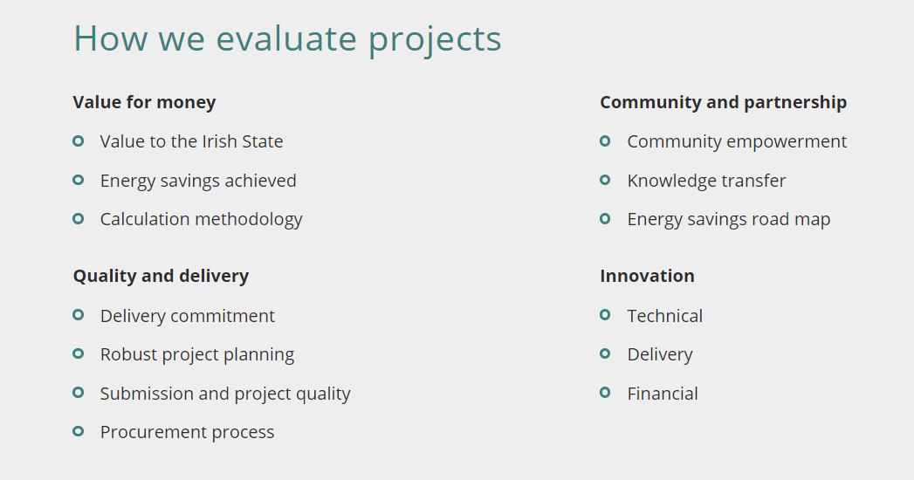
SEAI Evaluation
Notes:
TEA Total cost of €1.8M and grants worth €560,000

Slide 15
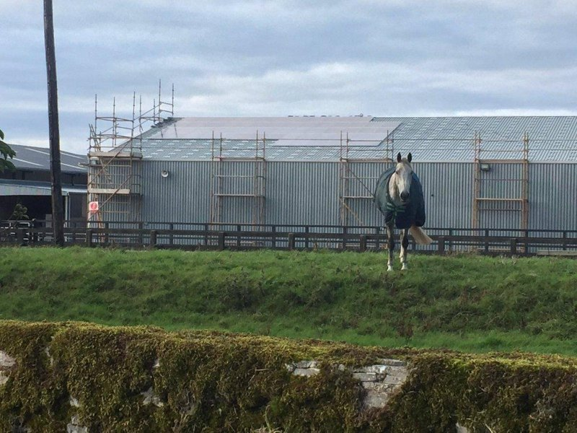
Gurteen Agri College

Slide 16
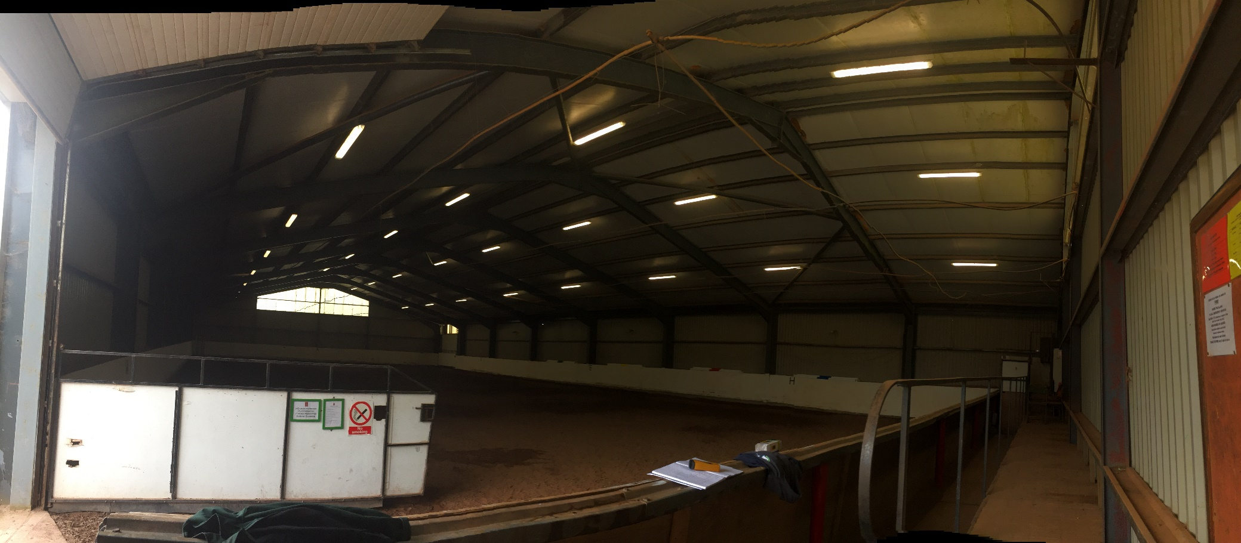
GUTEEN AGRICULTURAL COLLEGE

Slide 17
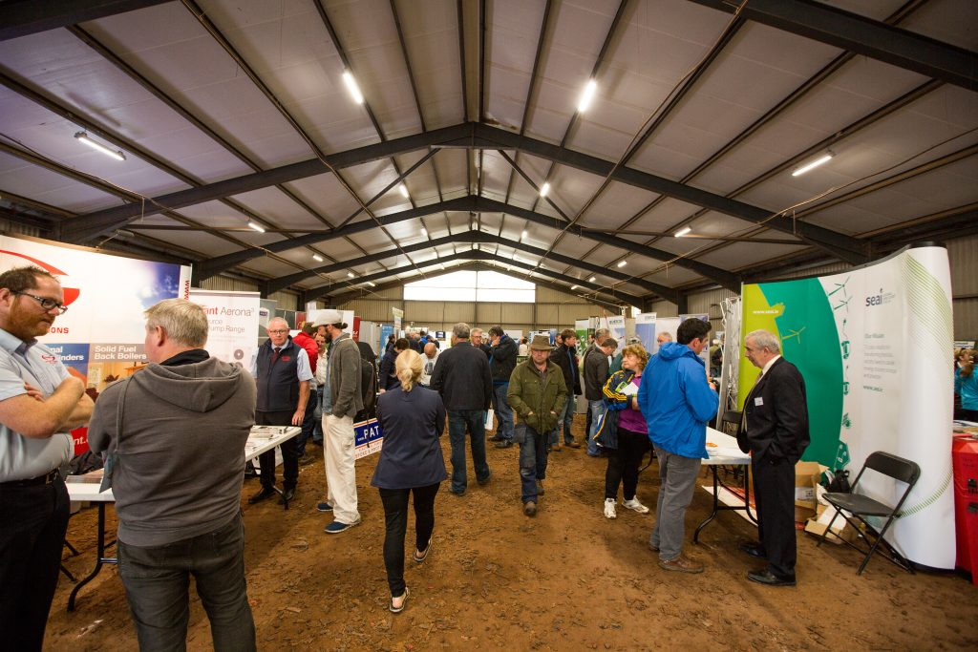
New LED Lighting

Slide 18

Scouts Hall Nenagh

Slide 19
PV
< €1000 per kW
<€50,000 for 50kW
50kW * .10 = 5kW
5*8760 = 43,800kW
43,800 * 0.15 = €6,570
€50,000/€6,570 = 7.6 years
7.6*.7=5.32 years simple pay back

Slide 20
EEOS
Government Energy Efficiency Obligations Scheme (EEOS).
Energy savings in terms of primary energy kWh
‘validated credits’ means savings which have been reviewed by SEAI and are countable against the obligated party’s annual targets;
Agreement with Obligated Party must be in place prior to undertaking the measures\
Tipperary Energy Agency 2012-2016 C. €1M brokered.
Selling any energy saving product => use credits to increase profit or volume.

Slide 21
Renewable Electricity
Support Scheme (RESS)
Assist Ireland in meeting it’s 40% renewable electricity target by
4th September released the consultation paper on the development of the new Renewable Electricity Support Scheme (RESS)
Notes:
On Monday of last week (4th September), the Department of Communications, Climate Action and Environment released the much-anticipated consultation paper on the development of the new Renewable Electricity Support Scheme (RESS) for Ireland which will eventually be the successor to the current REFIT 2 & 3 schemes.

Slide 22
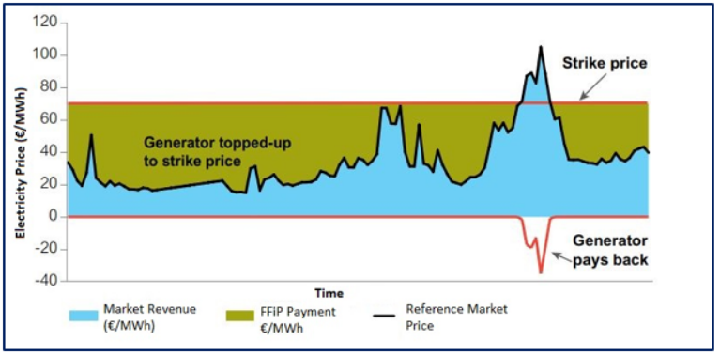
Auction Process
Notes:
All generators successful in the auction then receive the same uniform clearing price, or strike price.

Slide 23
RHI
12% target of heat derived from renewable energy sources by 2020. (2016 -6.6%)
The scheme is aimed at encouraging industrial and commercial heat users.
Cover additional costs of generating heat from renewable sources by providing a payment on a ‘per unit of energy produced’ basis.
Notes:
It is expected that the design of the RHI scheme will accelerate Ireland’s efforts to meet the country’s 12% target of heat derived from renewable energy sources by 2020.
the scheme will cover additional costs of generating heat from renewable sources by providing a payment on a ‘per unit of energy produced’ basis.

Slide 24
Best Practice guides
NEVER be stuck for information on energy saving!
Best practice guides available free
Almost every industry has commissioned guide/ study/ case study
Written for the industry
Ireland (SEAI), UK (Carbon Trust)

Slide 25
Non profit, public good social enterprise
Energy management, renewable energy and energy efficiency.
Public good consultancy, Market development actions, private sector consultancy
Energy audits, feasibility, implementation, design, project management, signoff.
Cutting edge expertise
16 expert staff
Alan Jackson
T: 052 7443090
F: 052 7443012
E: alan@tippenergy.ie
W: tippenergy.ie
Thanks for your time. Questions??

