Slide 1
Southern Region Waste Management Office

Slide 2
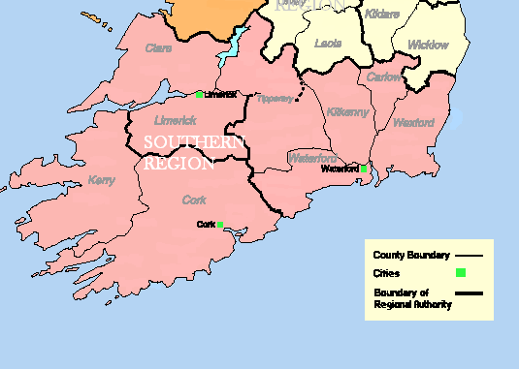
Southern Region Waste Management Plan 2015-2021
Ten local authorities:
Carlow
Clare
Cork City
Cork County
Kerry
Kilkenny
Limerick (Joint Lead)
Tipperary (Joint Lead)
Waterford
Wexford

Slide 3
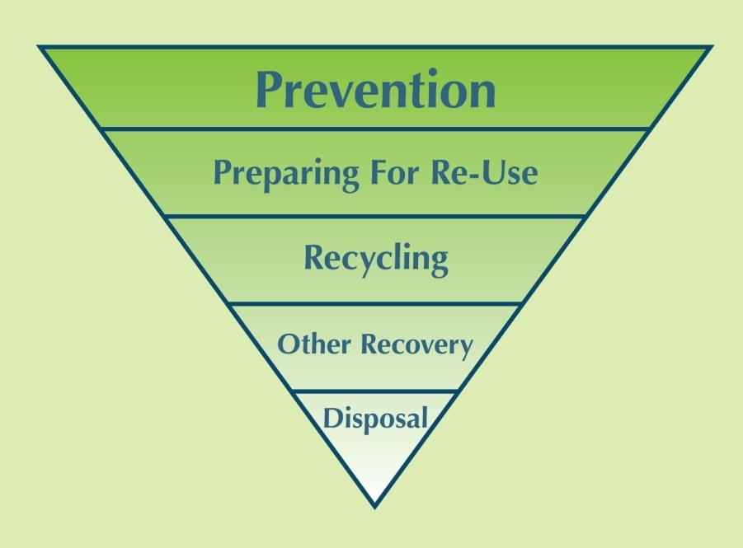
Waste Prevention & The Circular Economy
Waste Hierarchy
Circular Economy

Slide 4
Southern Waste Region Links
Local Authorities
Local Enterprise Offices
Business Networks e.g. TGBN
Dept of Environment / EPA
Green Business Programme
SMILE Resource Exchange
EcoMerit Certification
Enterprise Ireland
Energy Agencies
......

Slide 5
Example of SRWMO Support: EcoMerit Programme
Phil Walker
Econcertive
Onsite Guidance
Follow up advice
Cost Savings
Environmental Certification
www.ecomerit.ie

Slide 6
Tel 061 556596
Email: margaret.murphy@srwmo.ie
www.srwmo.ie

