Slide 1
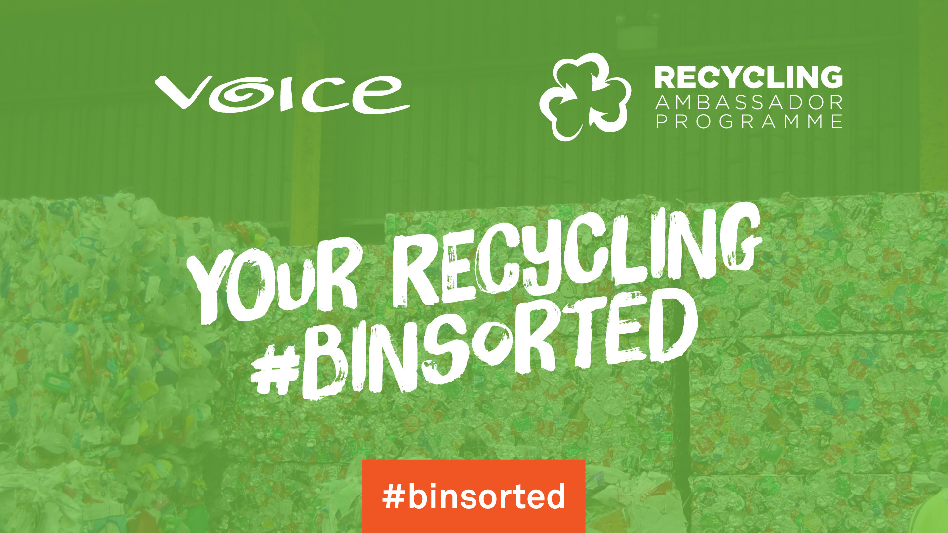

Slide 2
What goes in your recycling bin?
Aluminium Cans: Drinks cans, Soda Cans, Beer Cans
Steel Cans: Pet food Cans, Food Cans, Biscuit Tins, Soup tins
Paper: Newspapers, Magazines, Junk Mail, Envelopes, Paper, Phonebooks, Catalogues, Tissue box, Sugar bags, Calendars, Diaries, Letters, Computer paper, Used Beverage & Juice Cartons, Milk Cartons, Egg Boxes, Holiday Brochures, Potato Bags Cardboard: Food Boxes, Cereal Boxes, Kitchen roll tubes, Parcel Boxes

Slide 3
What plastic goes in your recycling bin?
Plastic
PET1 Mineral Bottles, Water Bottles, Mouthwash bottles, Salad Dressing Plastic Bottles
HDPE2 Milk Bottles, Juice Bottles, Cosmetic bottles, Shampoo bottles, Household Cleaning Bottles, Laundry Detergent Bottles, Window Cleaning Bottles, Bathroom Bottles
Plastic Pots, Trays & Tubs Yoghurt Pots, Margarine Tubs, Rigid Food Trays, Liquid Soap Containers, Fruit Trays/cartons

Slide 4
Eliminate any confusion
Help you recycle better
Reduce contaminated bins & make it easy!
Is it clean?
Empty & Loose

Slide 5
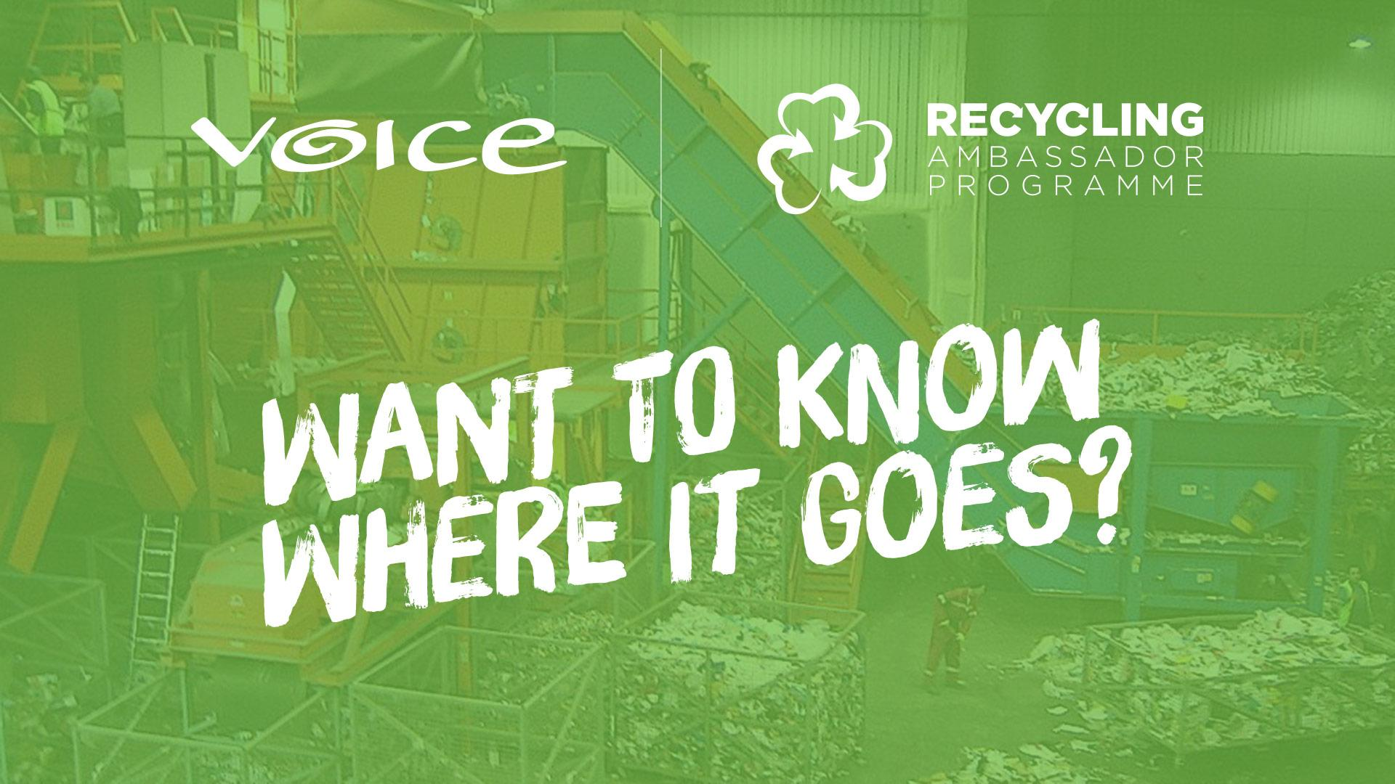

Slide 6
MRF
Materials
Recovery
Facility

