Slide 1
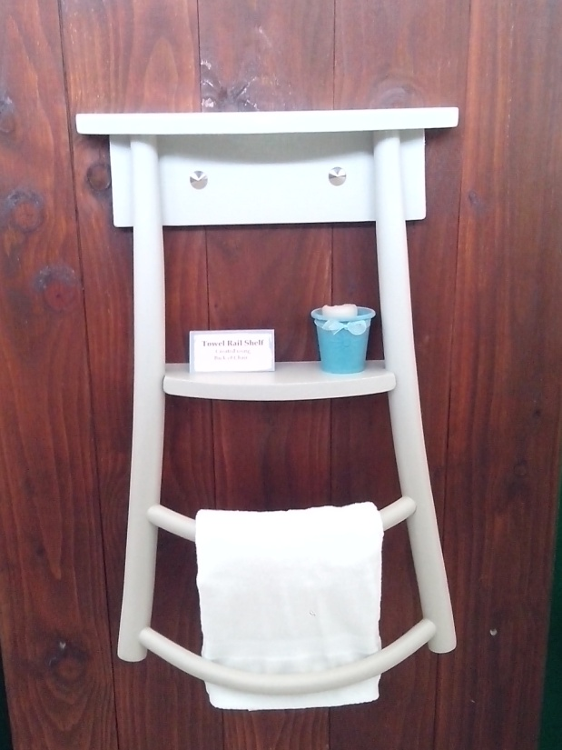
Dave Corboy
087 0546224
info@revivedandretro.ie
Bespoke Upcycling
Sales & Commissions
Training & Workshops
www.revivedandretro.ie
Towel rail made from re-purposed chair
www.revivedandretro.ie

Slide 2
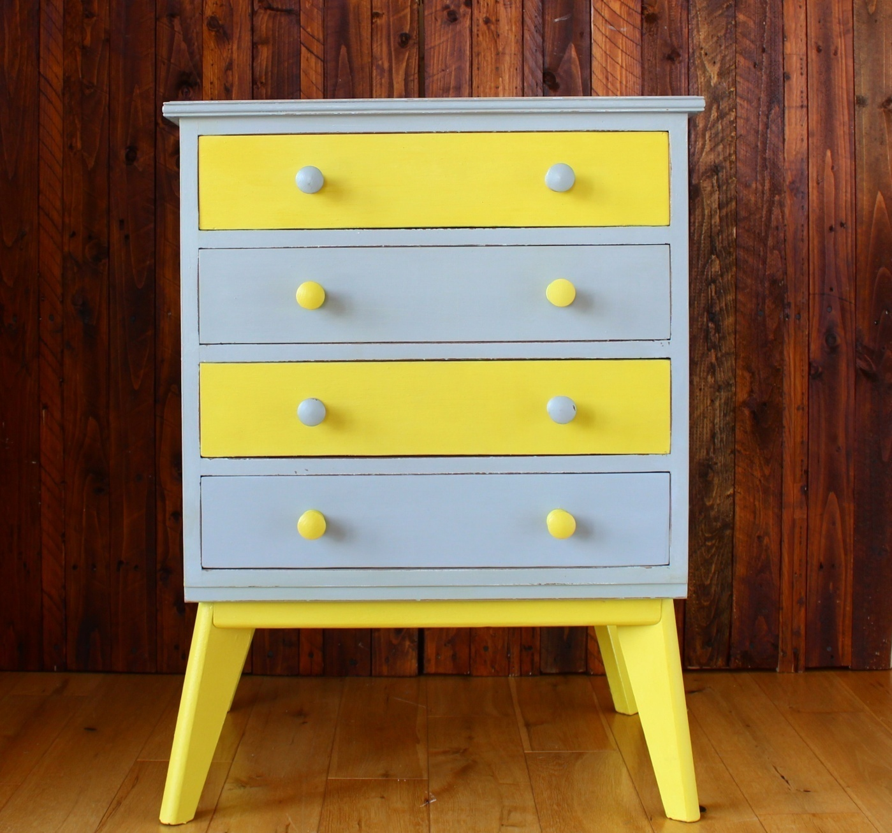

Slide 3
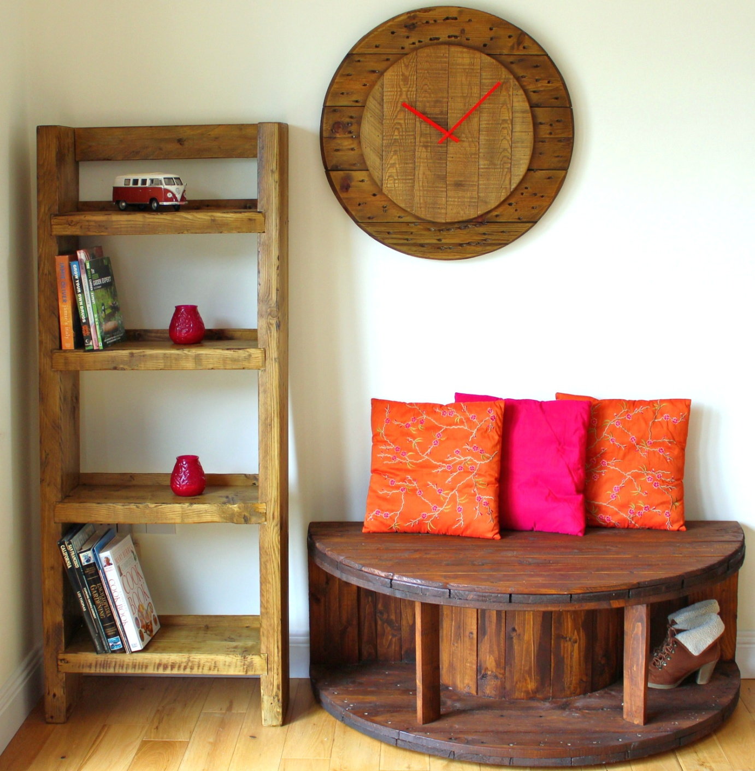

Slide 4
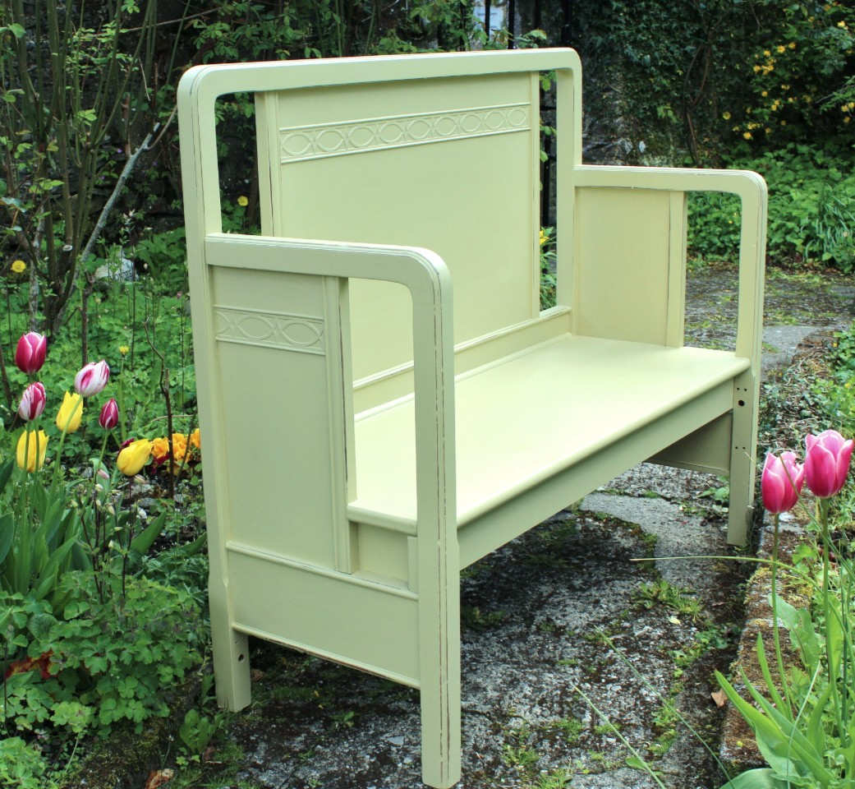

Slide 5
