Slide 1
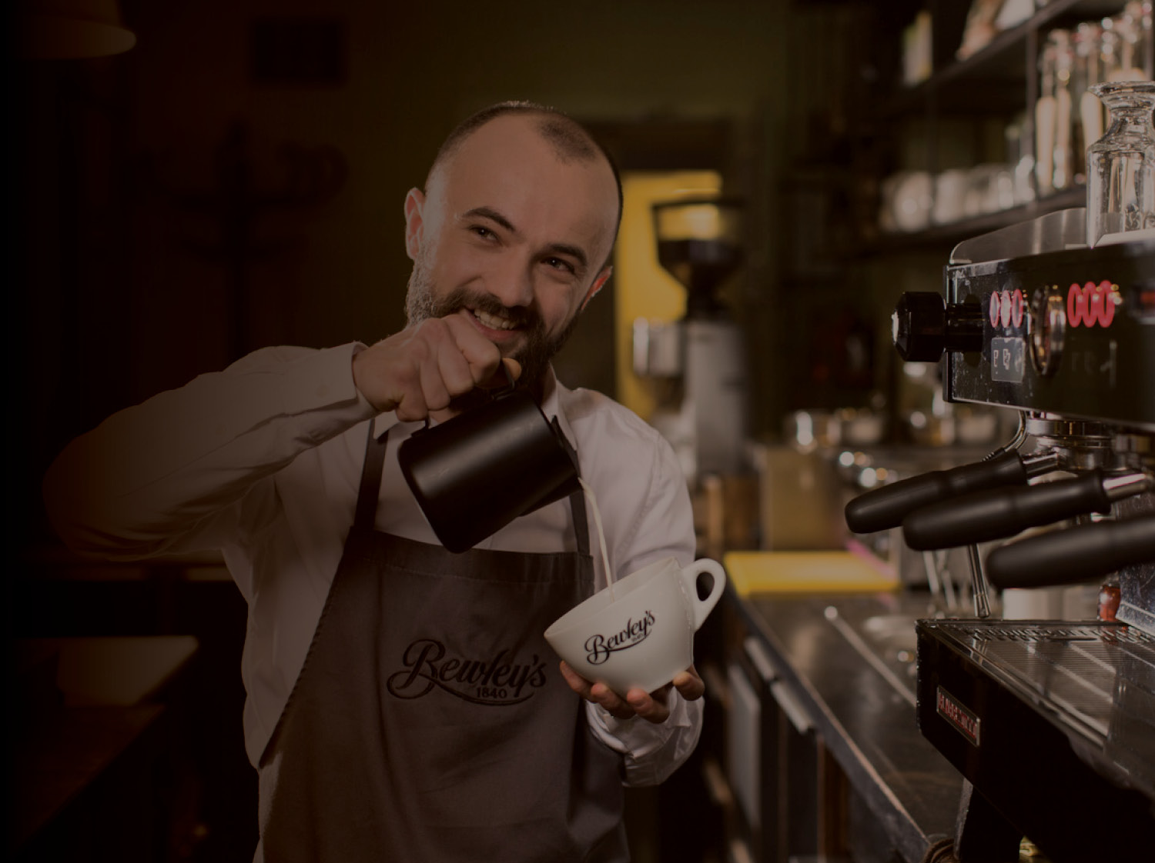
Bewley’s
An Introduction
11th May 2016
Eamonn Diver

Slide 2
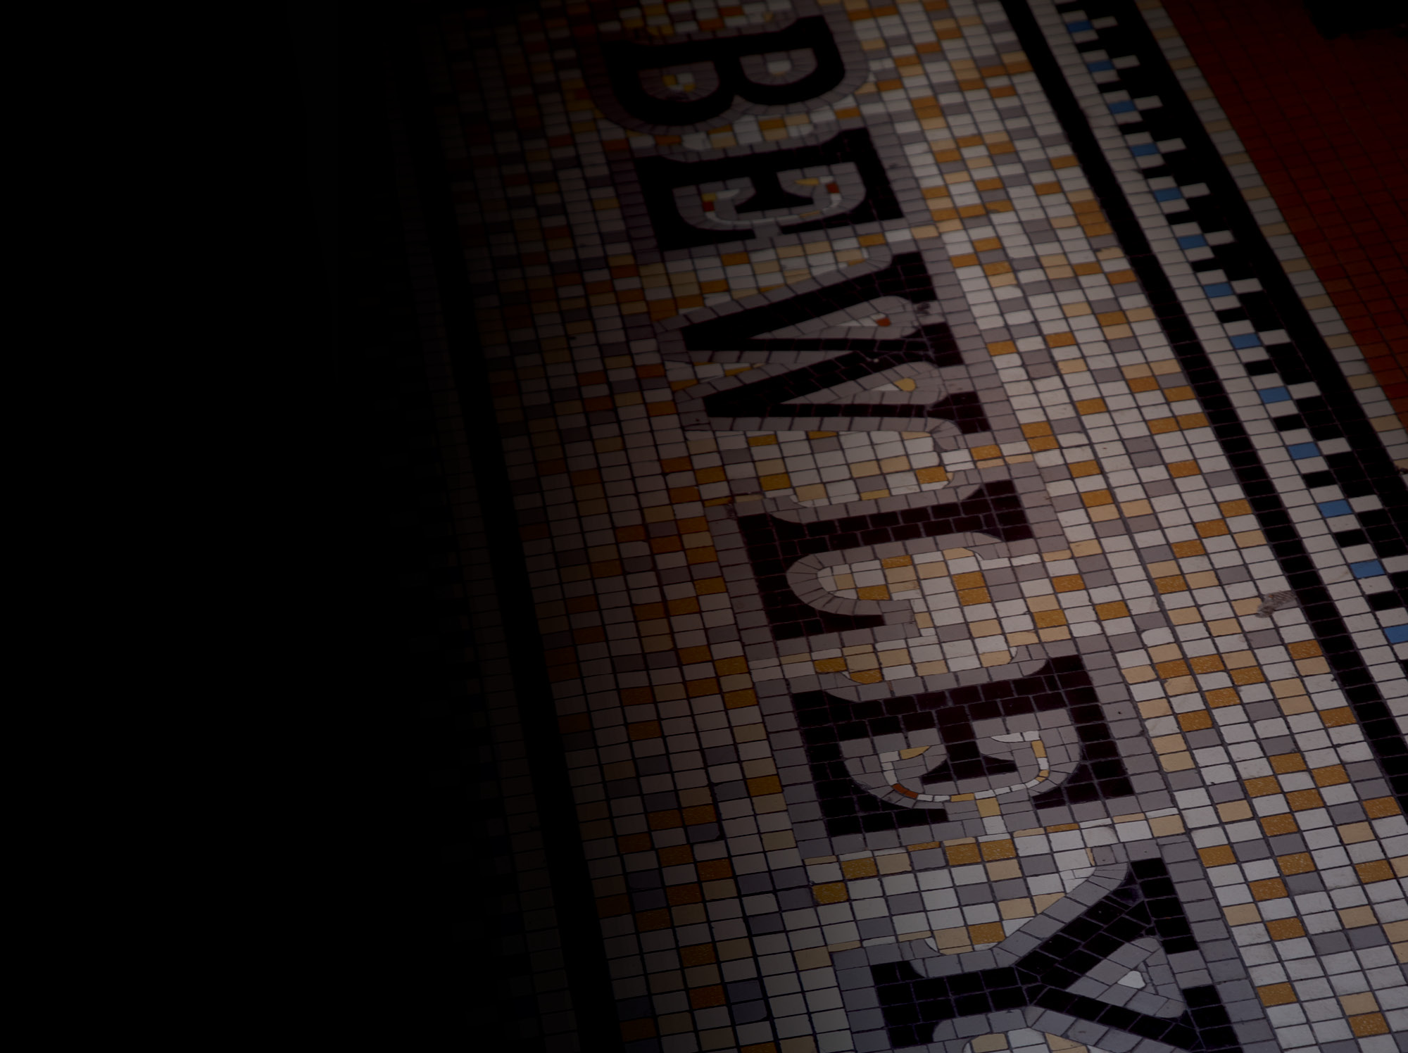
Agenda
About Bewley’s
Our Sustainability Journey
Energy Efficiency to-date
Sustaining the Results

Slide 3
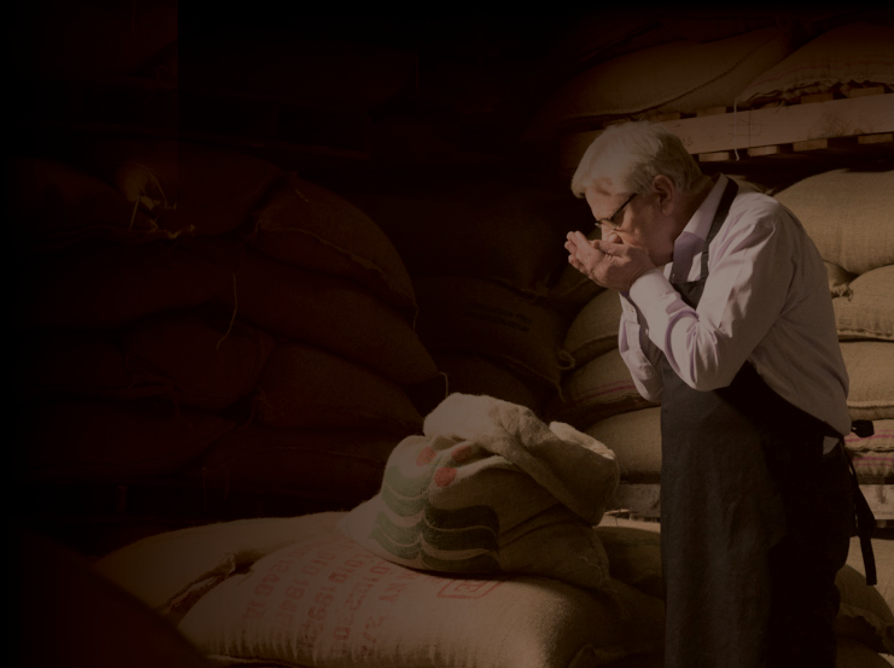
^{ABOUT BEWLEY’S}

Slide 4
Ernest Bewley
1861 - 1932
Patrick Bewley
Great grandson of Joshua Bewley carries on the proud Bewley’s tradition

Slide 5
Our Mission and Vision
^{Mission:}
^{“To Delight the Senses”}
^{Vision:}
“Bewley’s... On the lips of discerning Tea and Coffee drinkers in our chosen markets”

Slide 6
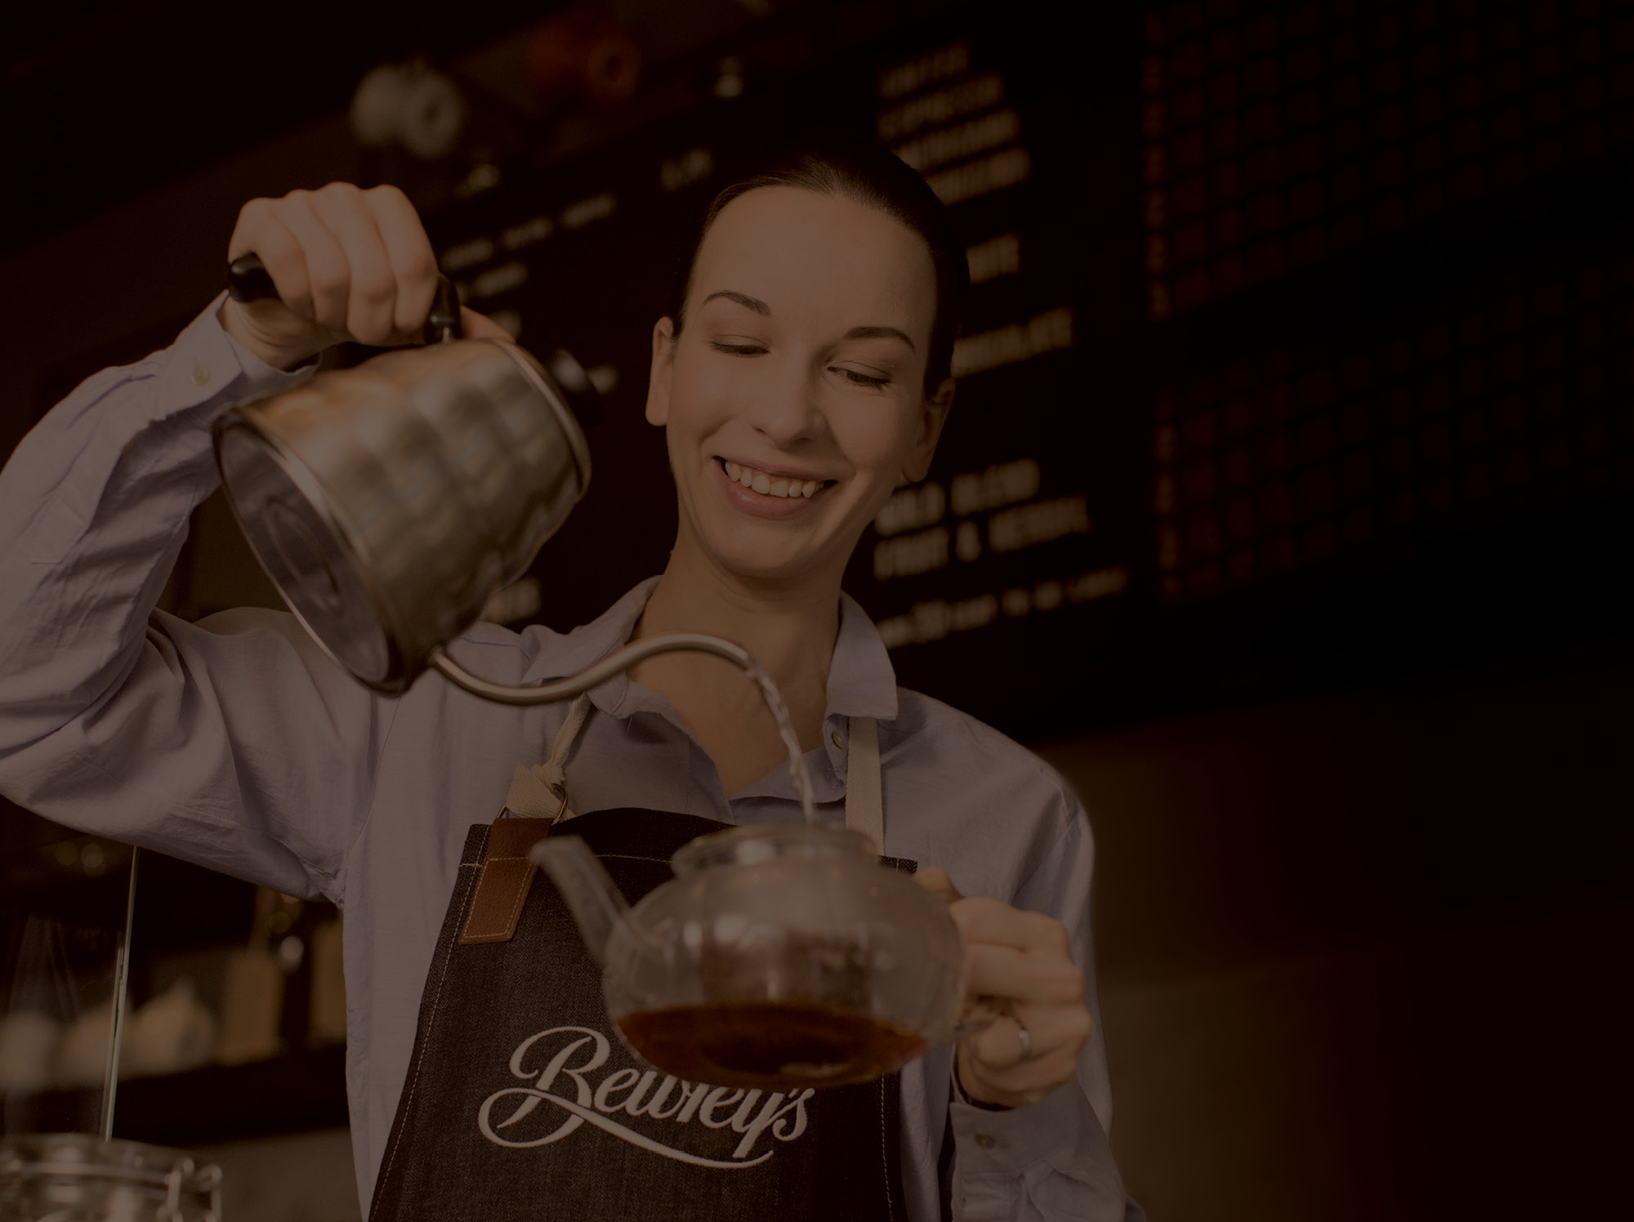
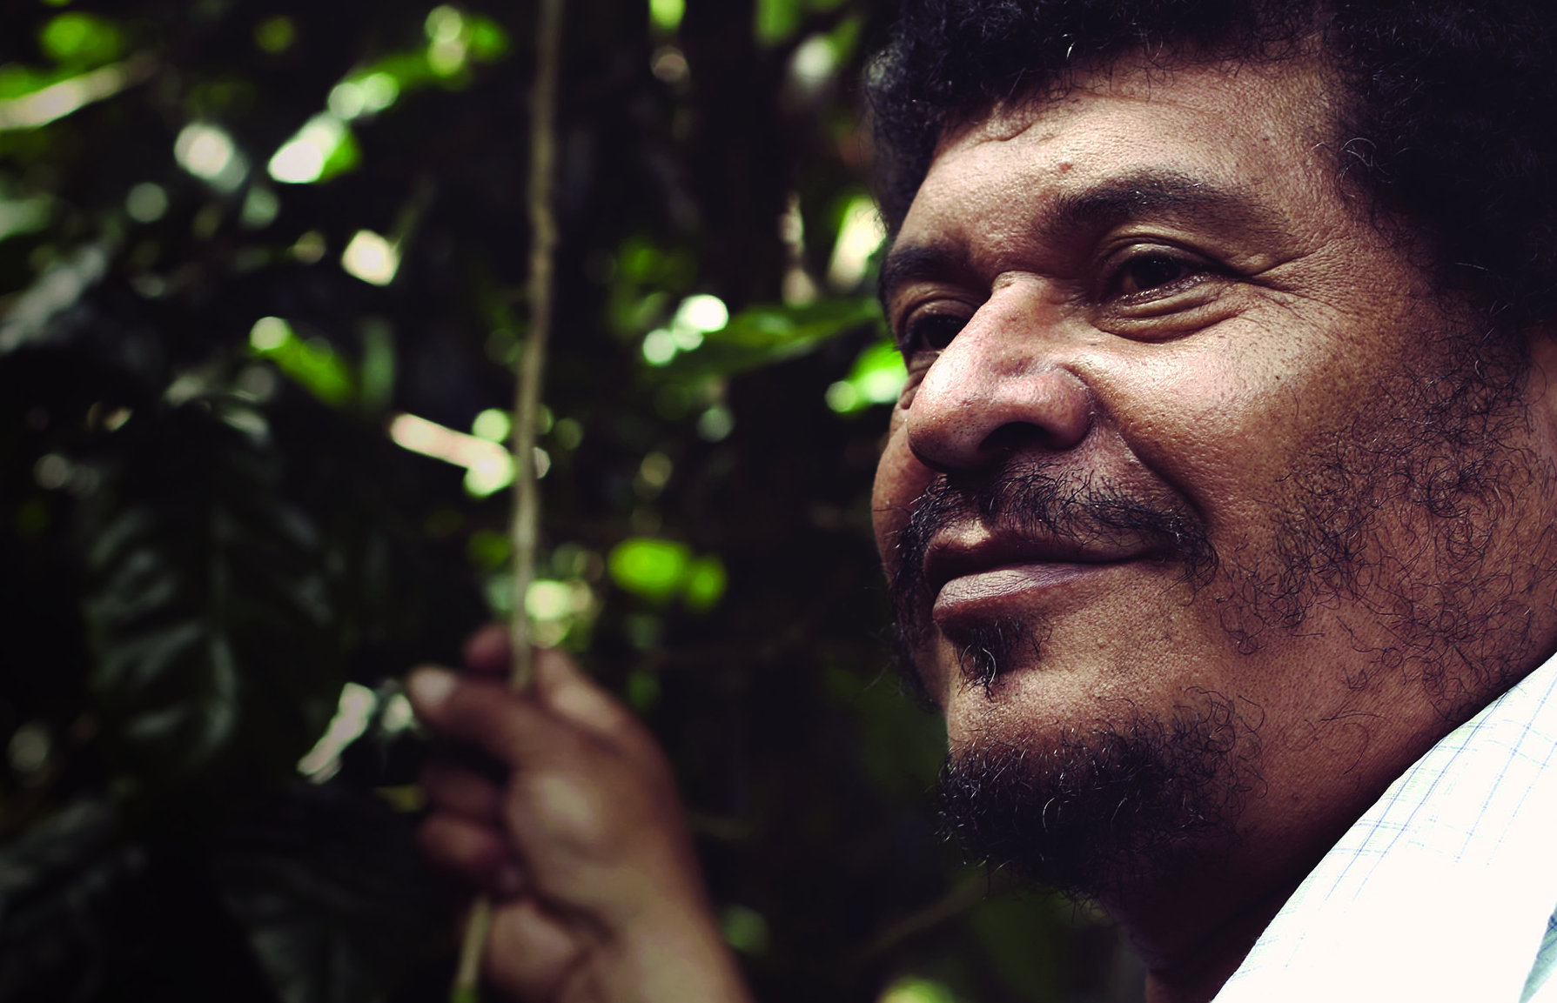
Our Values
^{We do what we say we will do}
We are enterprising and resourceful
^{We respect people}
We make our planet a better place to be

Slide 7
Group Profile

Slide 8
Group Facilities

Slide 9
^{OUR SUSTAINABILITY JOURNEY}

Slide 10
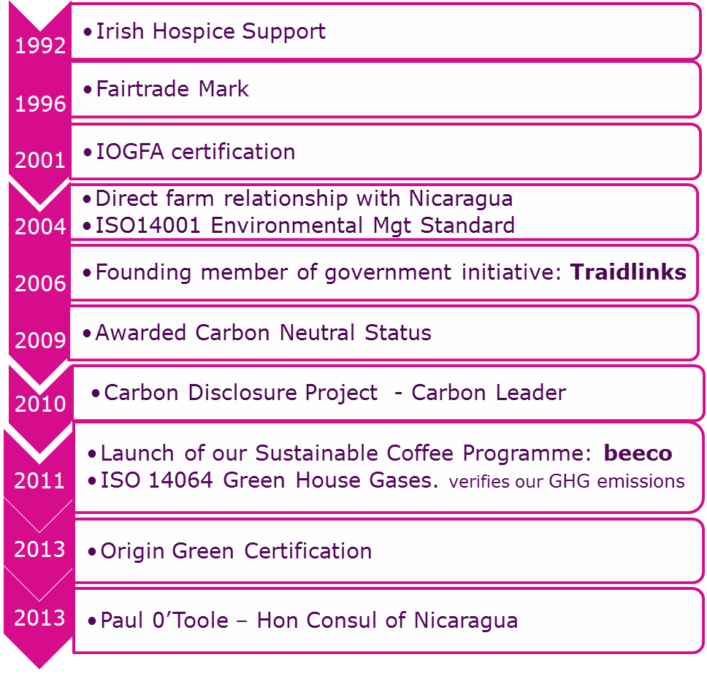
Sustainability-The Milestones
Notes:
Started supporting hospice in 92 / awarded fairtrade mark in 96 (1st coffee company in Ireland)

Slide 11
Credentials
ISO14001:2004 Environmental Management System since 2004
ISO14064-1:2006 Attestation of Co2 emissions – since 2011
Irish Organics Farmers & Growers Association (IOFGA) Organic Licence & Soil Association Organic Licence.
First Certified Carbon Neutral coffee company in Ireland in 2009
Carbon emissions reduction targets through energy management and waste reduction programmes and we have neutralized the remaining emissions through carbon offsetting.
Carbon Disclosure Project participant since 2010.
In the CDP Ireland Report 2011 and 2012, Bewley’s were deemed to be one of Ireland’s Carbon Leaders.
Comparing 2010 with 20016 data
We have reduced CO2e emissions per tonne of green coffee by 46%.
Reduction of 35 % of electrical kwh per tonne manufactured.
Reduction of 38 % of thermal kwh per tonne manufactured.
Reduction of landfill waste by 40% in 2012 v 2010. Now 5% of site waste is sent to landfill.

Slide 12
^{ENERGY EFFICIENCY TO DATE}

Slide 13
Efficiency Improvements 2010 - 2016
Annual Electrical Energy Usage Per KG of Product - 38% Reduction Annual Thermal Energy Usage Per KG of Product - 33% Reduction
Notes:
Some of the projects completed = Lighting upgrade / Roaster Insulation / Sub Metering of SEU’s & also on air/nitrogen / VSD on motors / PLC logic improvements

Slide 14
Energy Management
Notes:
These results were only achievable through a structured energy management system which includes a committed and dedicted team of people from various sectors throughout the business.

Slide 15
Sustainability in Bewley’s How it works for us
Central to the success of our Sustainability activities
1. Organisational structure
Cross-functional “Green Team”
Regular meetings with progress review against KPI’s
Updates on all areas of work and related targets are issued to all employees as part regular business updates.
2. Board commitment
Quarterly progress reports to the board of directors against outlined objectives and targets.
3. Management incentivisation
KPI setting and bonus payments incentivise delivery of targeted sustainability outcomes.

Slide 16
^{SUSTAINING THE RESULTS}

Slide 17
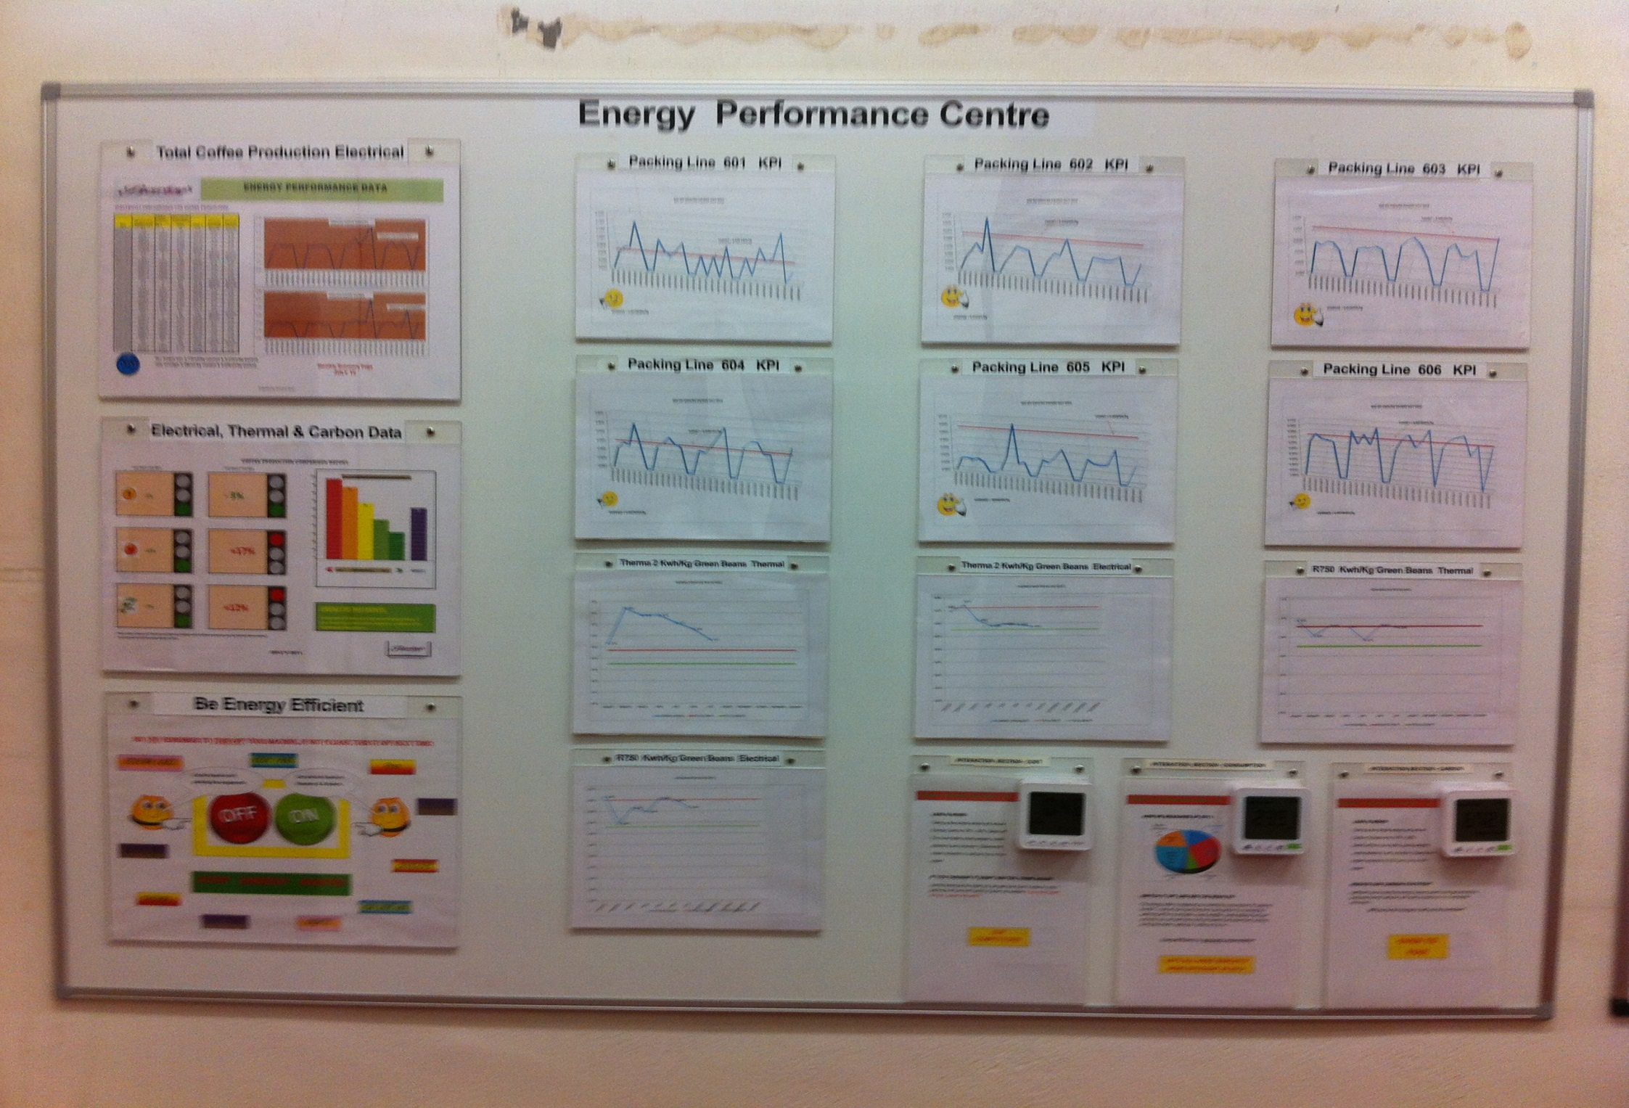
Education & Awareness
Notes:
Part of all employee training which ensures Energy Management is integrated into everyday activities

Slide 18
G R E E N
Notes:
Made up of representatives from different sectors within the business, responsible for their area/sector to ensure consumption of both electrical & thermal energy within their specific area of responsibility is within set KPI targets. Meet monthly to discuss performance data which is obtained via in-house developed energy & efficiency software. Areas which exceed KPI on a daily basis within a given month will trigger auto email alerts to the person responsible for this area and all email alerts are listed/discussed during monthly meeting.

Slide 19
If we measure it, we can manage it!
Thank You Any Questions ?

